Slide 1
Deep Neural Network based Stable Digital Predistortion using ELU Activation for Switchless Class-G Power Amplifier
Presenter：Xiaoqi Yu
（Date）18/05/2024

Slide 2
Contents
1、Background & Introduction
2、The proposed Digital Predistortion Algorithm
3、Experimental validation & Discussion
4、Conclusion
Notes:
Here is the contents of my presentation.

Slide 3
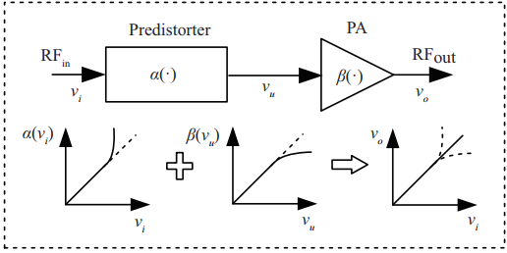
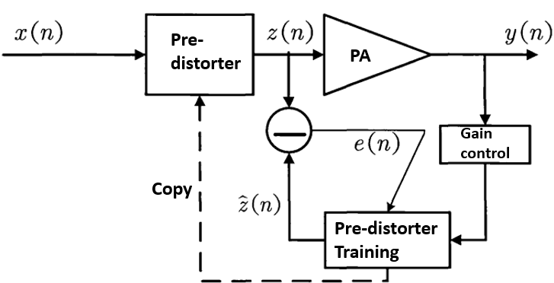
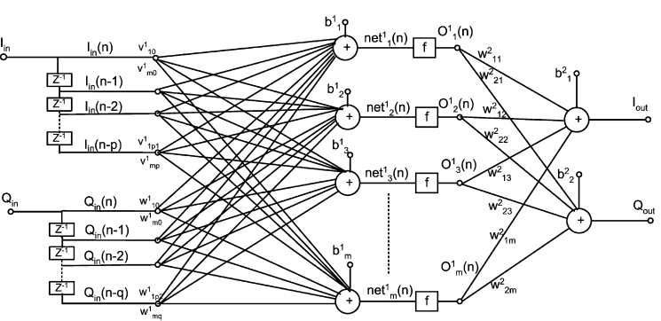
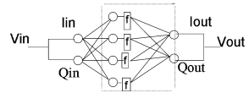
1. Background & Introduction
Digital Predistortion(DPD) is a crucial linearization technique for Power Amplifier (PA). Fig. 1 shows the fundamental principle and indirect learning (IL) structure of DPD algorithm in the paper. And it is the most vital to model the PA behavioral characteristics precisely.
Fig. 1. Fundamental principle (left) and block diagram of DPD system with indirect learning architecture (right).
Back propagation (BP) neural network and its variations have attracted extensive research interest in PA modeling, especially real-valued focused time-delay neural network (RVFTDNN)[1][2].
Fig. 2. BP neural network (left) and RVFTDNN [1][2].
[1] M. Rawat, K. Rawat, and F. M. Ghannouchi, “Adaptive digital predistortion of wireless power amplifiers/transmitters using dynamic real-valued focused time-delay line neural networks,” IEEE Trans. Microw. Theory Techn., vol. 58, no. 1, pp. 95–104, Jan. 2010.
[2] Taijun Liu, S. Boumaiza and F. M. Ghannouchi, "Dynamic behavioral modeling of 3G power amplifiers using real-valued time-delay neural networks," in IEEE Transactions on Microwave Theory and Techniques, vol. 52, no. 3, pp. 1025-1033, March 2004, doi: 10.1109/TMTT.2004.823583.
Notes:
Fig 2 shows the structure of the network.

Slide 4
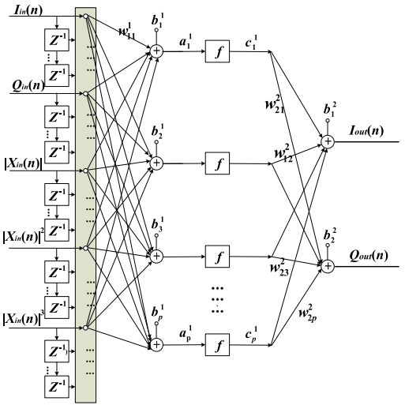
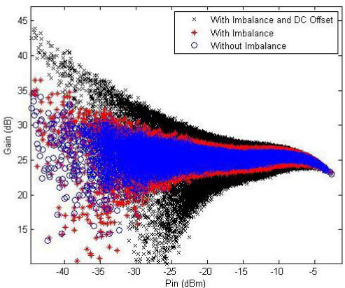
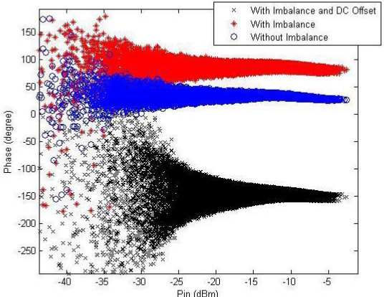
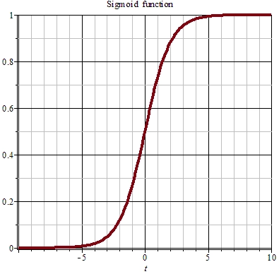
1. Background & Introduction
In 2019, augmented real-valued time-delay neural network (ARVTDNN) based DPD was proposed which toke into account the envelope-dependent terms [3]. The adding terms make the proposed model generate richer basis function set, which further improve the modeling accuracy.
It is proved that solve the dc offset, I/Q imbalance, and nonlinear PA distortions of a transmitter system by one-step (Fig. 4).
Fig. 3. Block diagram of ARVTDNN[3].
Fig. 4. Characteristics of the transmitter system. (Left) Gain characteristics.
(Right) Phase characteristics.[3].
Fig. 5. Sigmoid activation of common BP NN.
[3] D. Wang, M. Aziz, M. Helaoui and F. M. Ghannouchi, "Augmented Real-Valued Time-Delay Neural Network for Compensation of Distortions and Impairments in Wireless Transmitters," in IEEE Transactions on Neural Networks and Learning Systems, vol. 30, no. 1, pp. 242-254, Jan. 2019.
Notes:
Fig 4 shows the gain and phase characteristics with I/Q imbalance or DC offset(介绍Fig4).
In addition, the activation function of neuron is Sigmoid, and fig 5 shows the graph of Sigmoid.
In order to expend the potential performance of the ARVTD neural network.

Slide 5
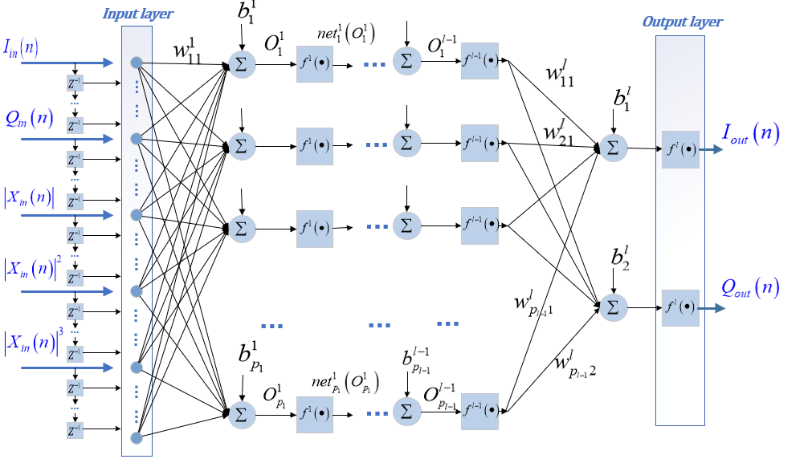
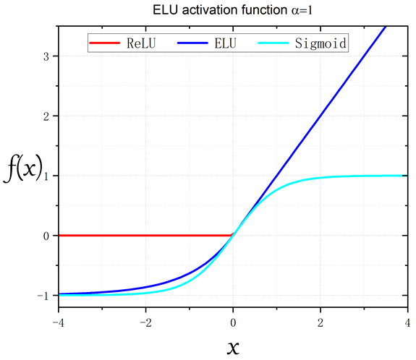
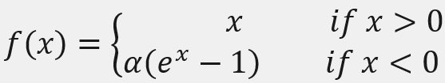
2. The proposed DPD
Fig. 7. The activations of neural networks (left) and the expression of ELU in the paper (right).
Fig. 6. The proposed Deep neural network (DNN) model.
To speed up the convergence of DNN and enhance the modeling accuracy, we utilize exponential linear unit (ELU) instead of Sigmoid/ReLU in this paper, which can avoid the gradient vanishing problem and ReLU inactive problem. [4][5]
New deep network structure based on the ARVTD.
Adopts 9 hidden layers where each contains 10 neurons.
Delay tap (m) and nonlinear order (k) are set to 2 and 4.
[4] R. Hongyo, Y. Egashira and K. Yamaguchi, "Deep Neural Network Based Predistorter with ReLU Activation for Doherty Power Amplifiers," 2018 Asia-Pacific Microwave Conference (APMC), Kyoto, Japan, 2018, pp. 959-961.
[5] Lu, Lu, et al. "Dying relu and initialization: Theory and numerical examples." arXiv preprint arXiv:1903.06733 (2019).
Notes:
Look at the fig 6
Fig 7 show the graphs of three activations mentioned, and the right one is the mathematic expression of ELU function.

Slide 6
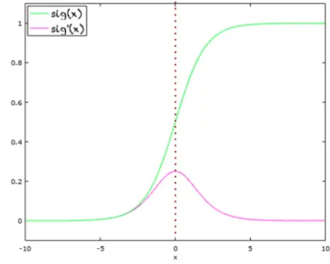
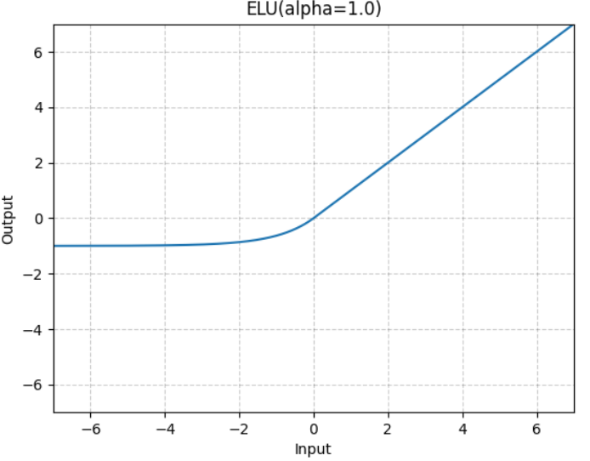
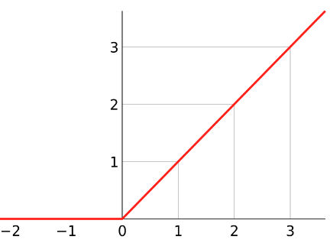
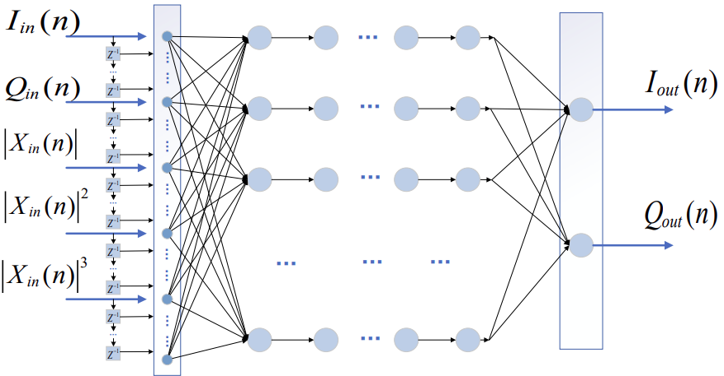
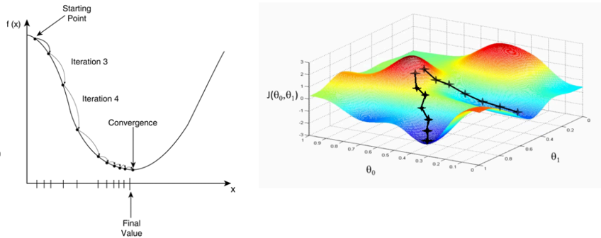
2. The proposed DPD
The derivative of activation is important for the convergence speed and accuracy of deep neural network.
Some problems can be avoided by using ELU in deep neural network.[4][5]
Small derivative
Zero derivative
Fig. 8. The activation of neural network. Sigmoid (Left), ReLU (Middle) and ELU (Right).
Speed up the gradient descent algorithm.
BP process
Fig. 9. Simple representation of gradient descent algorithm in backpropagation process.
Fig. 10. Negative-valued I/Q samples cause parts of neuron inactive in backpropagation process .
[4] R. Hongyo, Y. Egashira and K. Yamaguchi, "Deep Neural Network Based Predistorter with ReLU Activation for Doherty Power Amplifiers," 2018 Asia-Pacific Microwave Conference (APMC), Kyoto, Japan, 2018, pp. 959-961.
[5] Lu, Lu, et al. "Dying relu and initialization: Theory and numerical examples." arXiv preprint arXiv:1903.06733 (2019).
Notes:
This page shows the two problems mentioned above. In the training process of back propagation, …….
Look at the three pictures, the right is Sigmoid, it has small derivative in large input value range, which will slow down the process of finding the optimal value for loss function and cause the gradient vanishing problem like fig 9 showing to us. And the ReLU has enough derivative in positive input range, it can speed up the gradient descent algorithm. But in the negative input range, the derivative equals to zero, which means: the neuron in the network will be inactive when there are many negative samples, like the fig 10 showing.
However these problem ……….
Then, this is our proposed DPD technique.

Slide 7
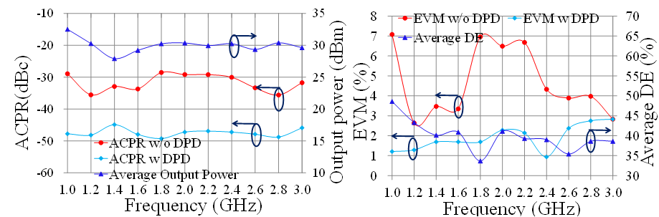
3. Experimental validation
SLCG PA is a recently developed back-off efficiency enhancement (BEE) technique that adopts two-quadrant modulation (TQM). The BEE technique brings new challenges for PA linearization.
In this experiment, SLCG PA shows poor linearity and linearizability under wideband modulated signal excitations.
Fig. 11. The SLCG PA used in the experiment.
Fig. 12. The modulated signal measurement results of the SLCG PA under 10MHz 64QAM signals.[6]
[6] X. Fang, R. Chen and J. Shi, "Switchless Class-G Power Amplifiers: Generic Theory and Design Methodology Using Packaged Transistors," in IEEE Transactions on Microwave Theory and Techniques, doi: 10.1109/TMTT.2024.3351852.
Notes:
The third part is experiment validation. Fig 11 and 12 show the Switchless Class G Power amplifier and the modulated signal measurement results of the PA under 10MHz 64QAm signals.

Slide 8
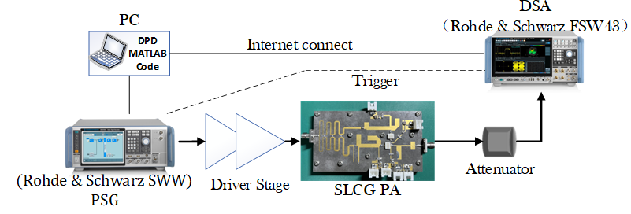
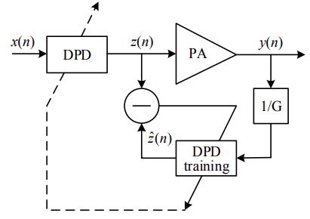
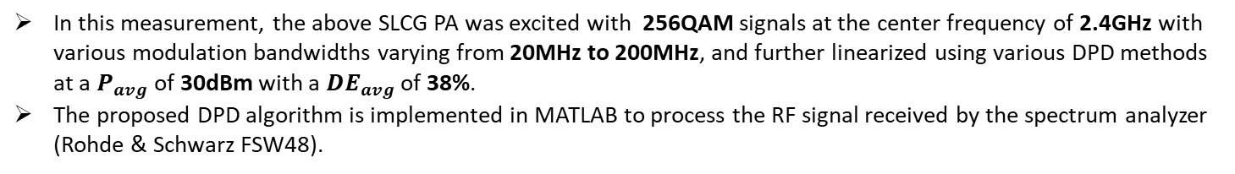
3. Experimental validation
Fig. 14. Indirect learning (IL) structure of the proposed DPD.
Fig. 13. Diagram of the proposed DPD measurement testbench.
In this measurement, the above SLCG PA was excited with 256QAM signals at the center frequency of 2.4GHz with various modulation bandwidths varying from 20MHz to 200MHz, and further linearized using various DPD methods at a $P_{avg}$ of 30dBm with a ${DE}_{avg}$ of 38%.
The proposed DPD algorithm is implemented in MATLAB to process the RF signal received by the spectrum analyzer (Rohde & Schwarz FSW48).
[6] X. Fang, R. Chen and J. Shi, "Switchless Class-G Power Amplifiers: Generic Theory and Design Methodology Using Packaged Transistors," in IEEE Transactions on Microwave Theory and Techniques, doi: 10.1109/TMTT.2024.3351852.
Notes:
The fig 13 shows the diagram of the proposed dpd measurement test-bench and fig 14 shows the indirect learning structure of dpd in this paper.

Slide 9
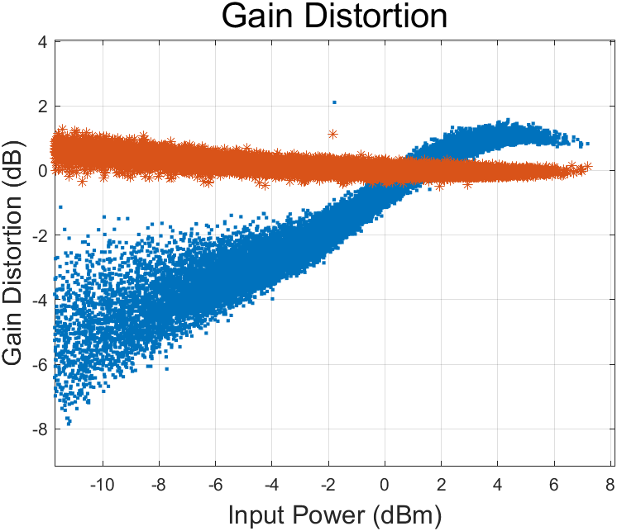
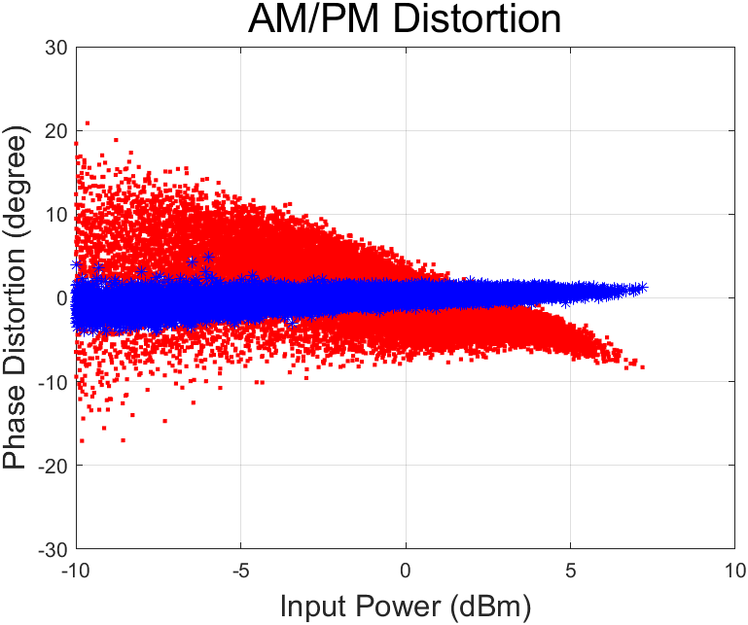
3. Experimental validation
Without DPD
With DPD
With DPD
Without DPD
Fig. 15. Normalized Gain distortion with and w/o the proposed DPD (200MHz 256QAM).
Fig. 16. Phase distortion with and w/o the proposed DPD (200MHz 256QAM).
The SLCG PA shows intense nonlinearity and memory effect under the wideband signal excitations (200MHz 256QAM modulated signals).
When apply the proposed DPD technique, the intense distortion of normalized gain and phase has been mitigated substantially (Fig. 15 and Fig. 16).
Notes:
Two pictures above show the normalized gain distortion and phase distortion with/without the proposed dpd.
In the pictures,
However,

Slide 10
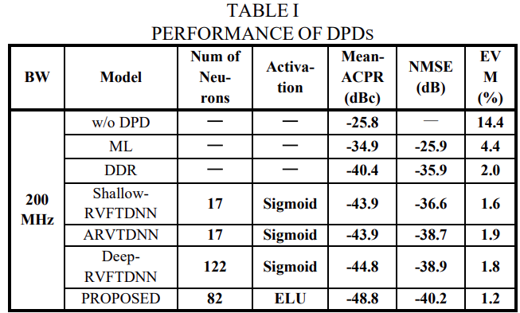
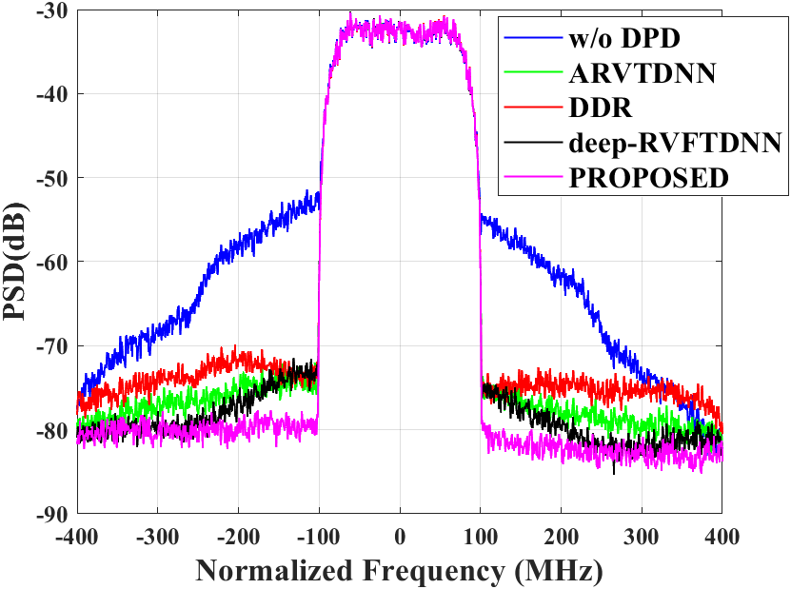
3. Experimental validation
Table. 1. Performance of DPDs applied to SLCG PA under 200MHz 256QAM signals.
Fig. 17. The PA output power spectral density with and without DPD.
Fig. 18. The DPD measurement results under various modulation bandwidths.
Comparing existing DPD methods, the proposed one offers a 4-8.4dB improvement in ACPR as well as about 1.3-4.3dB improvement in NMSE. Also, by applying ELU function in deep neural network, the training process can be accelerated about 3-4 times compared with Sigmoid (Table. 1) .
Fig. 18 illustrates the DPD measurement results for the signal modulation bandwidth swept from 20MHz to 200MHz.
The proposed DPD method can realize effective linearization for the nonlinear PA excited with wideband modulated signals.
Notes:
What is more, in table 1, …
In this picture, you can see,

Slide 11
4、Conclusion
Efficient: This paper proposes a deep neural network based DPD technique, which employs ARVTD-based input vector and adopts ELU function to replace the Sigmoid one in the neuron activation, and consequently avoids the gradient vanishing problem and accelerates the deep neural network training.
Stable: Experimental verification conducted on a SLCG PA demonstrates that the proposed DPD maintains excellent linearization performance and enhanced stability in the case of large signal modulation bandwidth.
Notes:
Lastly, in conclusion,
Then,

Slide 12
Reference
[1] M. Rawat, K. Rawat, and F. M. Ghannouchi, “Adaptive digital predistortion of wireless power amplifiers/transmitters using dynamic real-valued focused time-delay line neural networks,” IEEE Trans. Microw. Theory Techn., vol. 58, no. 1, pp. 95–104, Jan. 2010.
[2] Taijun Liu, S. Boumaiza and F. M. Ghannouchi, "Dynamic behavioral modeling of 3G power amplifiers using real-valued time-delay neural networks," in IEEE Transactions on Microwave Theory and Techniques, vol. 52, no. 3, pp. 1025-1033, March 2004, doi: 10.1109/TMTT.2004.823583.
[3] D. Wang, M. Aziz, M. Helaoui and F. M. Ghannouchi, "Augmented Real-Valued Time-Delay Neural Network for Compensation of Distortions and Impairments in Wireless Transmitters," in IEEE Transactions on Neural Networks and Learning Systems, vol. 30, no. 1, pp. 242-254, Jan. 2019.
[4] R. Hongyo, Y. Egashira and K. Yamaguchi, "Deep Neural Network Based Predistorter with ReLU Activation for Doherty Power Amplifiers," 2018 Asia-Pacific Microwave Conference (APMC), Kyoto, Japan, 2018, pp. 959-961.
[5] Lu, Lu, et al. "Dying relu and initialization: Theory and numerical examples." arXiv preprint arXiv:1903.06733 (2019).
[6] X. Fang, R. Chen and J. Shi, "Switchless Class-G Power Amplifiers: Generic Theory and Design Methodology Using Packaged Transistors," in IEEE Transactions on Microwave Theory and Techniques, doi: 10.1109/TMTT.2024.3351852.
[7] M. T. Hagan and M. B. Menhaj, "Training feedforward networks with the Marquardt algorithm," in IEEE Transactions on Neural Networks, vol. 5, no. 6, pp. 989-993, Nov. 1994.
[8] Haykin, Simon, and N. Network. "A comprehensive foundation." Neural networks 2.2004 (2004): 41.
[9] F. M. Ghannouchi and O. Hammi, "Behavioral modeling and predistortion," in IEEE Microwave Magazine, vol. 10, no. 7, pp. 52-64, Dec. 2009.

Slide 13
Thank you! Q&A

